Slide 1
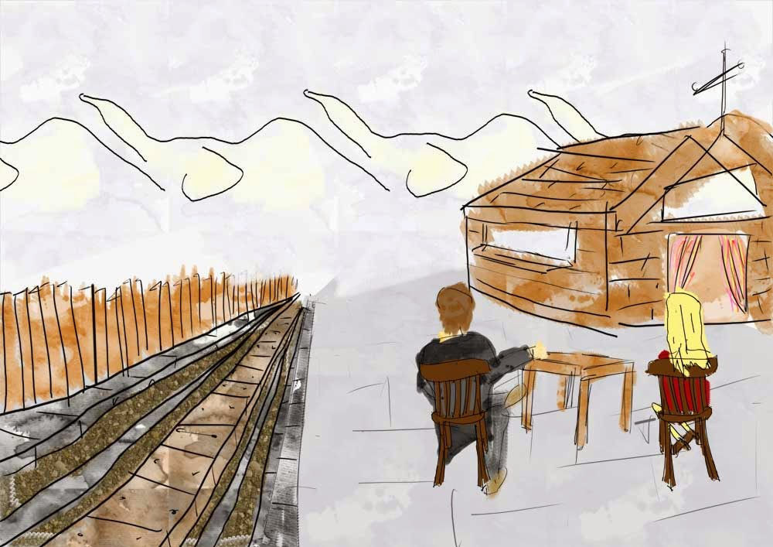

Slide 2
Cyrenaics
I possess, I am not possessed .
Aristippus c. 435 – c. 356 BCE

Slide 3
Epicureanism
Non fui, fui, non-sum, non-curo .
I was not; I was; I am not; I do not care .
Epicurus 341–270 BC

Slide 4
Don't fear god
Don't worry about death
What is good is easy to get
What is terrible is easy to endure

Slide 5
Dead people are not concerned whether their bodies are buried in coffins, cremated, dumped in water or in a ditch; nor whether the body is dressed in fine clothes. What matters most is that before death strikes one lives life to the fullest.
Yang Zhu

Slide 6
cynicism
I'd rather be mad than feel pleasure.
Antisthenes 446 – c. 366 BCE

Slide 7
Stoicism
sick and yet happy, in peril and yet happy, dying and yet happy, in exile and happy, in disgrace and happy.
Epictetus 50 – c. 135 AD

Slide 8
Charvaka
There was nothing wrong with sensual pleasure. it is impossible to have pleasure without pain, and wisdom lay in enjoying pleasure and avoiding pain as far as possible.

Slide 9
Christianity
perfect happiness cannot be found in any physical pleasure, any amount of worldly power, any degree of temporal fame or honor, or indeed in any finite reality. It can only be found in something that is infinite and perfect – and this is God.
Thomas Aquinas 1225 – 1274

Slide 10
empiricism
pleasure and pain are both the measure of ethical value and the main motivators fueling the passions.
Reason is, and ought only to be the slave of the passions .
David Hume (1711–1776)

Slide 11
utilitarianism
Nature has placed mankind under the governance of two sovereign masters, pain and pleasure.
Individuals should promote the greatest good for the greatest number of people.
Jeremy Bentham (1748–1832)

Slide 12
Suffering is necessary to achieve greatness rather than something to be avoided.
Friedrich Nietzsche (1844–1900)

Slide 13
Malicious pleasures, like enjoying the suffering of others, do not have inherent value.
Richard Brandt (1910–1997)

Slide 14


Slide 15
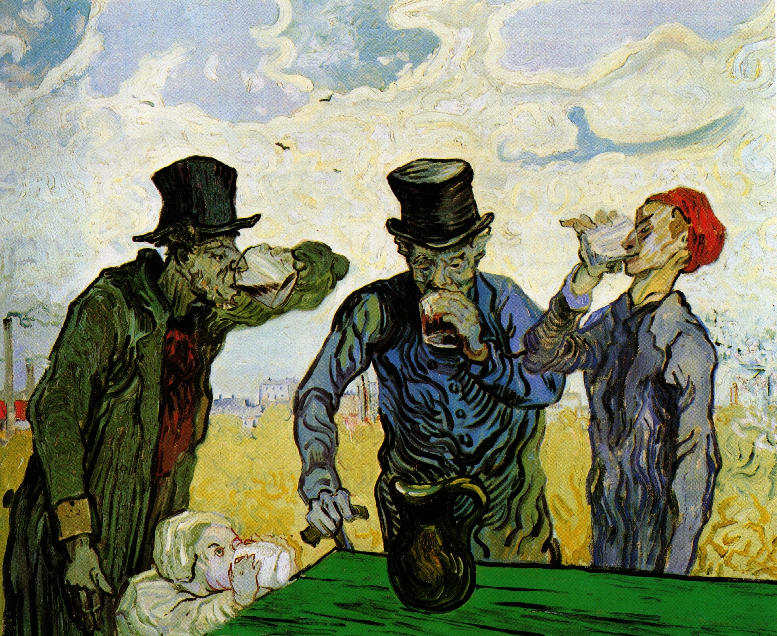

Slide 16
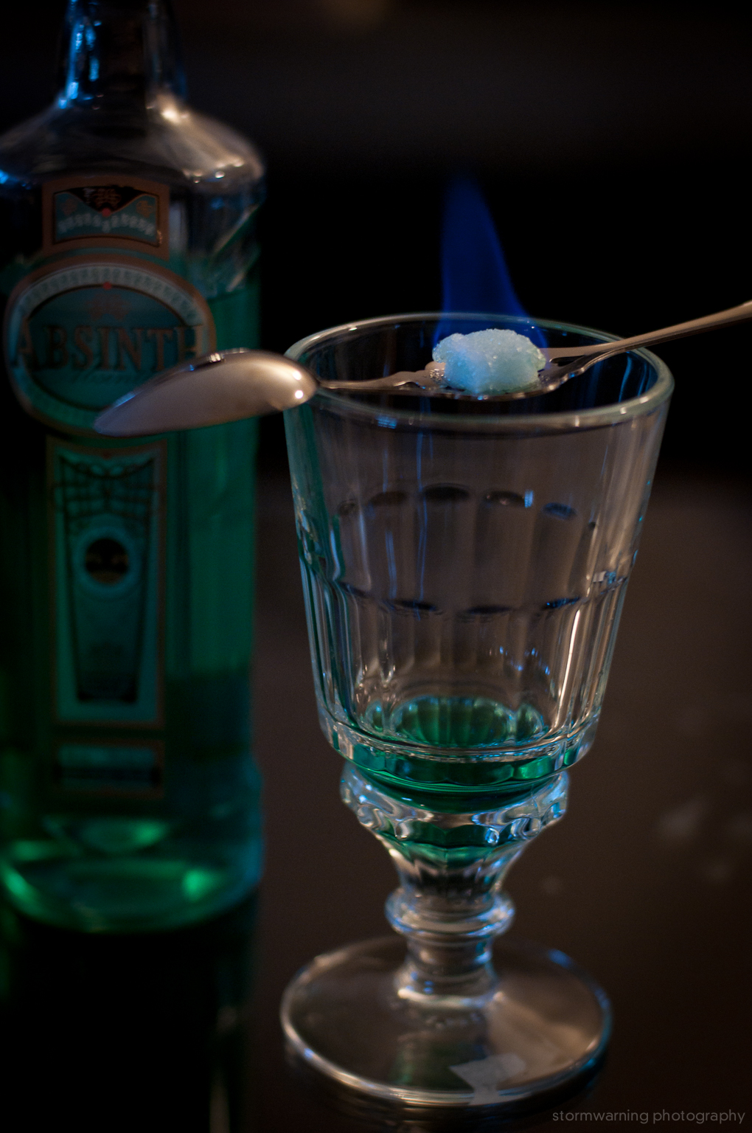
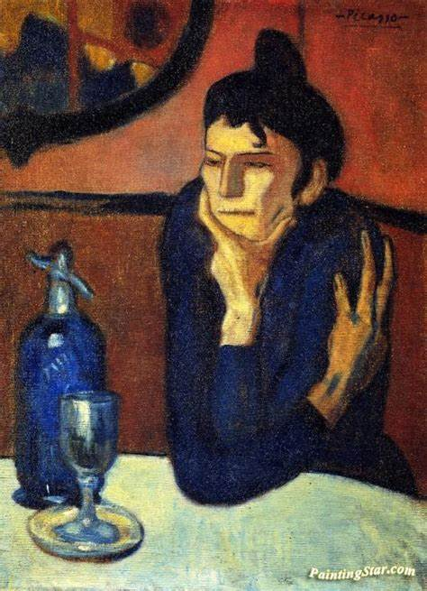

Slide 17
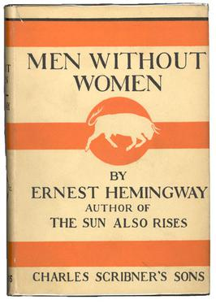

Slide 18
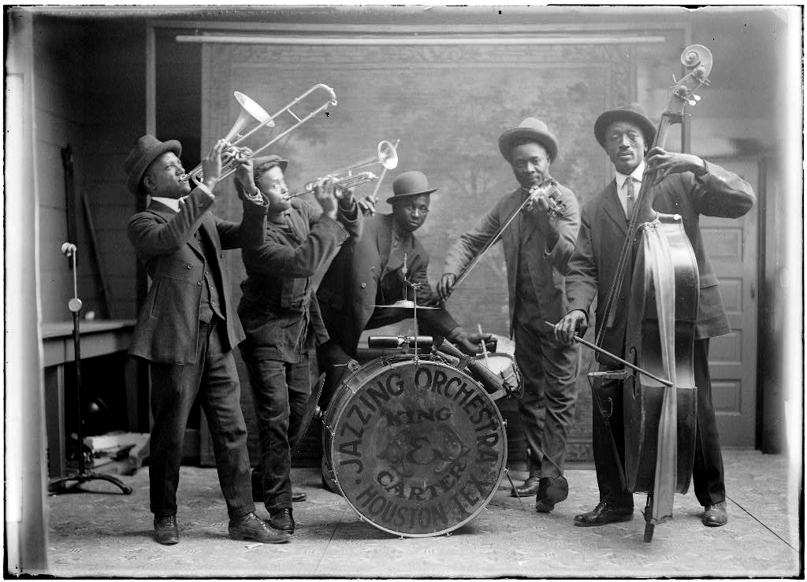

Slide 19
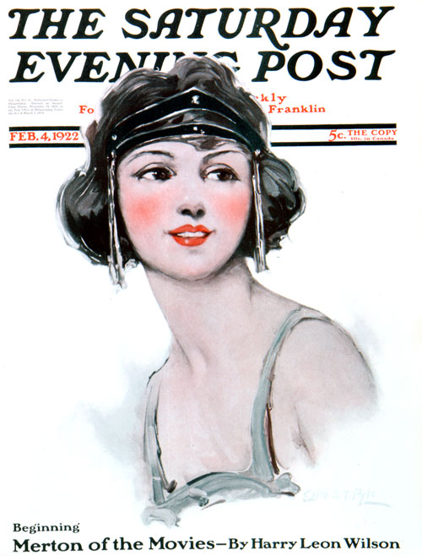

Slide 20
